Slide 1
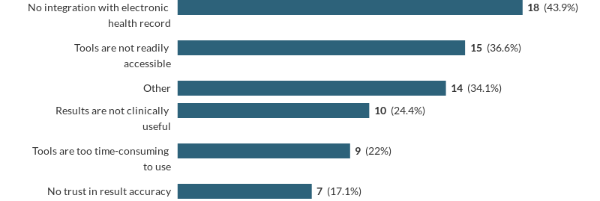
Individualised risk scoring in elective colorectal cancer surgery:
Why don’t we do it?
M. Ayres, D. Drayton, C. Downey
Leeds Institute of Medical Research, St. James University Hospital, Leeds
Introduction
All patients undergoing major elective surgery should have an estimate of risk communicated to them¹.
Several risk assessment tools are available to facilitate this².
Not all patients receive a personalised risk assessment when having elective colorectal surgery.
We sought to investigate why.
Methods
We circulated an electronic survey to all general surgeons and anaesthetists at Leeds Teaching Hospitals NHS Trust.
Participants had one month to respond.
This study received ethics committee approval from the University of Leeds Medical Research Ethics Committee (MREC21-073 ).
What data did we collect?
Do you use risk scoring tools when considering a patient for elective colorectal cancer surgery?
If yes, which one(s)?
Other than risk scoring tools - do you provide an overall estimate of risk to patients having elective colorectal cancer surgery?
Is this estimate: Numerical? Based on experience? Based on a risk score?
In your opinion, what do you feel are the barriers to using risk scoring tools when assessing patients for major elective surgery?
Results
We had 43 respondents, 33 of whom routinely assess patients for elective colorectal surgery.
7 were surgeons and 26 were anaesthetists. 80% were consultants.
66% provide an overall estimate of risk to patients.
55% use risk scoring tools.
Discussion
Roughly half of patients having elective colorectal surgery do not receive individualised risk estimates.
Tools used are heterogenous and not necessarily validated for this population e.g. the NELA risk calculator.
Conclusion
Clarity on which tools to use and how to present this data to patients is needed.
An understanding of clinicians’ perceptions of IRSs is required to design implementation solutions.
This work is independent research arising from an Academic Clinical Fellowship (MA) and an Academic Clinical Lectureship (CD) supported by the National Institute for Health Research. The views expressed in this publication are those of the authors and not necessarily those of the National Health Service, the National Institute for Health Research, Health Education England or the Department of Health.
Figure 1: Perceived barriers to using individualised risk scoring tools
References:
Findlay, G.P. et al. NCEPOD 2011. Knowing the Risk: A Review of Peri-Operative Care of Surgical Patients. Available at: https://www.ncepod.org.uk/2011poc.html
Moonesinghe S.R, et al. Anesthesiology 2013; Risk stratification tools for predicting morbidity and mortality in adult patients undergoing major surgery: qualitative systematic review, 119(4): 959-981.

